Slide 1
Programming Skills Workshop
Lesson 4 –Tips and Tricks

Slide 2
Course Schedule
Tues 22nd – Intro
Wed 23rd – Windows Administration
Thu 24th – Windows Command Line
Wed 30th – Cancelled
Thu 31st – Programming Tips & Tricks
Wed 6th – Programming Tools
Thu 7th – Linux
Wed 13th – More Linux & Languages
Thu 14th – Group Work & More Tools

Slide 3
Course Resources
Course items up on GitHub
https://github.com/kcarta/programming-workshop
These will be updated weekly

Slide 4
Today’s Lesson
A wide range of topics, from coding to troubleshooting to computer hardware.
What you’ll learn:
Skills: Coding, troubleshooting, finding high-quality sources.
Knowledge: (more hard-earned wisdom than straight knowledge), computer parts.
Values: The right mindset makes a big difference in programming.

Slide 5
Coding

Slide 6
Clean Code
“Any fool can write code that a computer can understand. Good programmers write code that humans can understand”
Martin Fowler
Code is meant to be read and understood by humans.
For this reason alone, it is important to keep you code clean and organized.

Slide 7
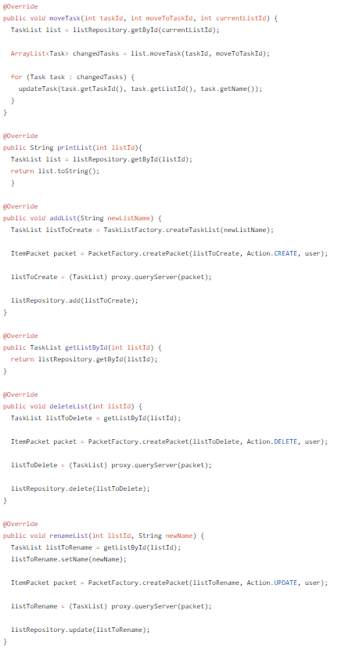
Code Structure
Humans read code like we read everything else.
Code should look and feel like a walkthrough to solving a problem, not like abstract poetry.
Long blocks of text or deeply-nested indentations are tough to follow at a glance.
Use indentation and newlines to keep your code structured.

Slide 8
Naming
“There are only two hard things in Computer Science: cache invalidation and naming things.”
Phil Karlton
Handy rules for naming things:
Follow conventions for your language/platform (Google it!)
Avoid repetition (String nameString -> String name)
Use full words, not single letters or abbreviations
Unless it’s convention, like i for iterators and T for generics
When in doubt, clarity wins over simplicity
Ask “does this name fully describe what this does?”

Slide 9
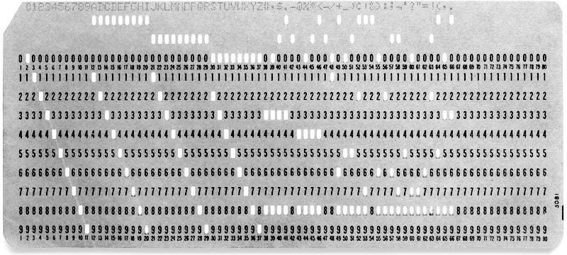
Code Length
Longer code is harder to understand.
Code should be kept short and sweet.
Follow principles instead of worrying about exact numbers:
Classes and methods should do one thing
Don’t Repeat Yourself
Don’t write code that you “might” need eventually
- Separate high-level and low-level code with abstractions

Slide 10
Code Organization
Well-structured code is easy to skim and understand, and
well-structured programs are delightful to navigate.
Keep your code organized by:
Following code conventions for structure & spacing
Keeping indentation levels to a minimum (refactoring helps)
Using packages/namespaces and organizing code in folders

Slide 11
// Comments
When learning a programming language, one of the first things shown is how to write comments.
Comments have more risks than benefits, and should be used carefully:
They are hard to maintain
They take up space and make code harder to read
An unclear, misleading or incorrect comment will lead to bugs.
Most of the time, hard-to-understand code should just be rewritten.
That said, there are certain instances where you need to have comments:
API documentation (Javadoc, for example)
Explaining math or complex algorithms that cannot be simplified

Slide 12

Code Rot and Technical Debt
Code tends to “go bad” as it gets older:
Solutions that made sense years ago may not be relevant today.
Older components become increasingly incompatible with newer and recently updated components.
Code might only make sense to its original author.
Technical debt can add up when too many “quick solutions” are done and then left unimproved.
These are inescapable facts of life, but techniques like writing tests and refactoring can help.

Slide 13
Refactoring
Write
Test
Refactor
Test
Code is rarely perfect when first written, and even great code will rot over time.
Rewriting code to improve it is a common practice, and is called refactoring. This process is usually combined with testing.
Maintaining code is important, but must be balanced with writing new features.
* This is not true TDD!

Slide 14
Helpful Resources
Codecademy – Guided coding lessons
www.codecademy.com/learn/learn-java
Derik Banas – The only good Java tutorial videos
www.youtube.com/watch?v=TBWX97e1E9g&list=PLE7E8B7F4856C9B19
Computer Science Crash Course – Great videos for explaining programming concepts
www.youtube.com/watch?v=tpIctyqH29Q&list=PL8dPuuaLjXtNlUrzyH5r6jN9ulIgZBpdo

Slide 15
Exercise 1: Cleaning Up Code
Using Eclipse, clean up the UglyMovement.java file (found on GitHub)
Look out for:
- Structure (especially indentation and newlines)
Names (“does this fully explain what it does?”)
Comments (“Is this comment necessary?”)
*No bonus points for using autoformatting!

Slide 16
Mindset & Troubleshooting

Slide 17

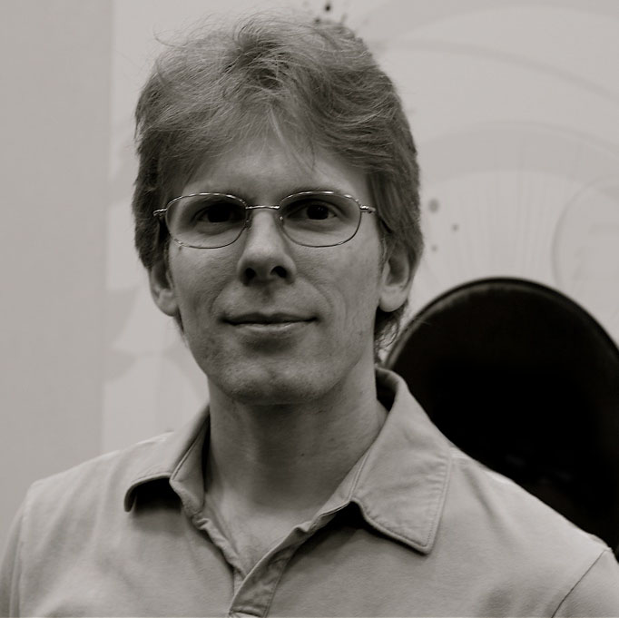
State of Mind Matters!
Programming is difficult.
(that’s why we get paid so much money!)
Having the right mindset will help you tackle the seemingly endless problems that will face you as a programmer.
The best programmers are often the ones that are the most persistent and curious.
What other helpful traits can you think of?

Slide 18
Confidence
Most programming tasks require taking lots of educated guesses.
On top of that, you’ll rarely know what to do when first approaching a new task.
Confidence can give you the curiosity and persistence to work through any IT task.
Just as a carpenter would never be afraid to use a hammer, you shouldn’t be afraid of your computer or any program on it!

Slide 19
The Impostor Syndrome
Since programming is difficult, you’ll find that every programmer struggles with confidence from time to time.
Even expert programmers with decades of experience can feel like they aren’t good enough, and that they don’t belong. Even when they’re writing code, they feel like at any time their peers will “reveal them” to be a fraud.
This lack of confidence is so common that it has a name – the Impostor Syndrome.
The best remedies for this are (once more) persistence and curiosity.

Slide 20
Asking Questions
Many IT professionals, especially software developers, are afraid to ask questions, in fear of exposing gaps in their knowledge.
This is a terrible mistake.
Programmers are always facing new challenges, and nobody can possibly be expected to know everything. All programmers get lost and feel stupid from time to time – the best know when and how to get help!
Asking good questions will help you keep pace, and shows others that you are interested, disciplined and motivated.

Slide 21
Solving Problems
Programming is essentially applied problem solving.
It is not enough to rely on hacking around or following tutorials.
To be a good ICT Engineer, you will have to learn how apply a process:
Understand the Problem
Break it into pieces if you need to
Devise a Plan
Carry out the Plan
Review

Slide 22
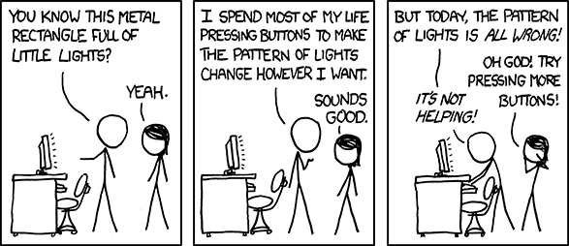
Troubleshooting
As an IT student, you should be able to work through most computer-related problems on your own.
Source:
http://xkcd.com/722/
The Secret of IT Troubleshooting:
You’ll almost never know the answer to a problem before it comes up.
Instead, a simple algorithm can be used to solve virtually any IT problem.

Slide 23
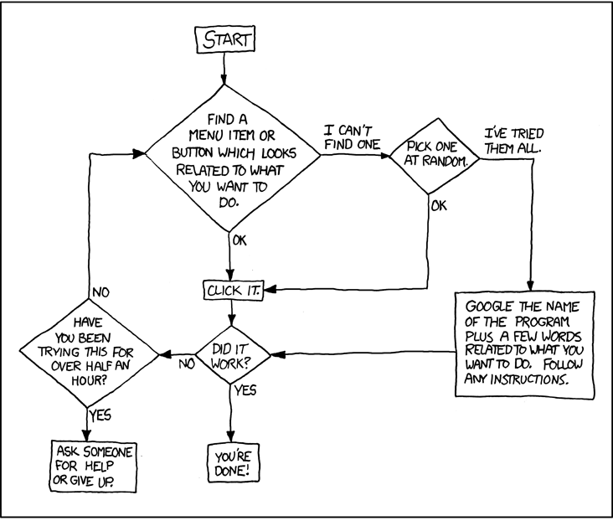
Troubleshooting Cheat Sheet
Source:
http://xkcd.com/627/

Slide 24
Exercise 2: Troubleshooting NPP & Eclipse
Using the troubleshooting cheat sheet, figure out how to
Select a new theme in Notepad++
Select a new theme in Eclipse
Autoformat Java code in Eclipse
Try this on a new copy of UglyMovement.java!
Advanced:
Play Tetris inside of Notepad++
Open and run the Java debugger in Eclipse (we’ll use this next lesson!)

Slide 25
Using high-quality sources
Not all sources of information are equal!
The Reference Hierarchy:
Official documentation and source code (Oracle Java API, MSDN docs)
Up-to-date books
Peer-reviewed documentation (Mozilla Developer Network)
Blog posts by expert professionals (Microsoft MVPs, CSS Tricks, etc.)
Stackoverflow (most of the time)
Forum threads (on reputable sites)
Blog posts on personal (non-ad) sites

Slide 26
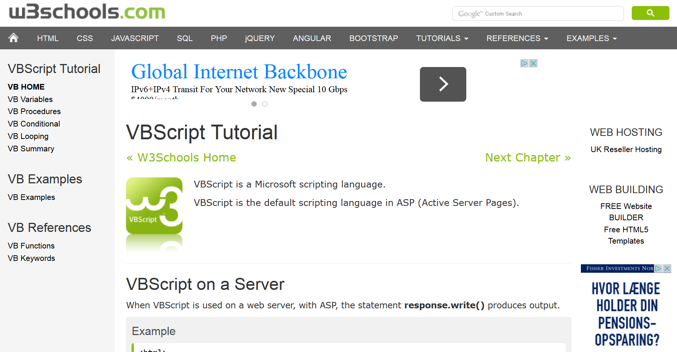
Avoiding low-quality sources
Not all sources of information are equal!
Poor sources include:
Ad-based ”tutorial” sites (W3Schools, About.com, WikiHow, etc.)
Make sure you can see who wrote the content, when they wrote it, and what their qualifications are!
Out-of-date books and documentation
Anything on a site that has too many ads, is outdated, or just plain looks bad

Slide 27

Source Quality Checklist
For every source, ask:
Who wrote this? Why should you trust them?
When was this written?
Is the information provided still relevant?
Why was this written?
What sources are provided? Are they relevant and up-to-date?
Apply the same process to all major sources!
Who paid for this to exist? Why?
Are there ads? Do they distract from the content?

Slide 28
Exercise 3: Comparing Sources
We’re going to learn about source quality by comparing two popular sources for the exact same topic.
Go to Google and search “javascript array sort”
The top results should be “Array.prototype.sort() - JavaScript | MDN” and “JavaScript Array sort() Method - W3 Schools”
Examine each of these sources with the Source Quality Checklist
Which source is more trustworthy, and why? Which is more useful?

Slide 29
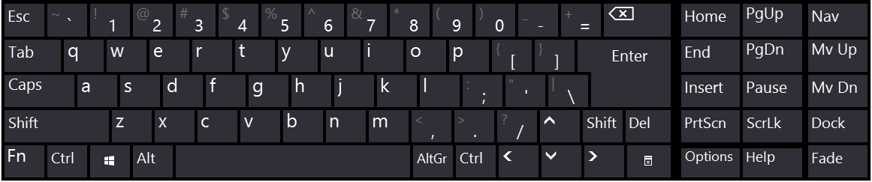
Typing
The keyboard is the only practical tool for writing code.
If your typing skills are weak, you will be frustrated by even simple coding tasks.
Keyboard mastery helps you use all sorts of programs, from code editors to design programs (and few things impress other programmers like a keyboard wizard!)

Slide 30
Typing Speed
A programmer should be able to type swiftly, without having to pause too often to find a key on the keyboard.
Typing skill is usually measured in words per minute (wpm).
At the lowest end, 40 wpm is enough for most time-sensitive tasks, like coding at an exam or programming with others.
Ideally, your typing speed should fall somewhere between 60 and 100 wpm.
Notes:
Typing speed test: http://10fastfingers.com/typing-test/
Touch typing practice: http://www.keybr.com/

Slide 31
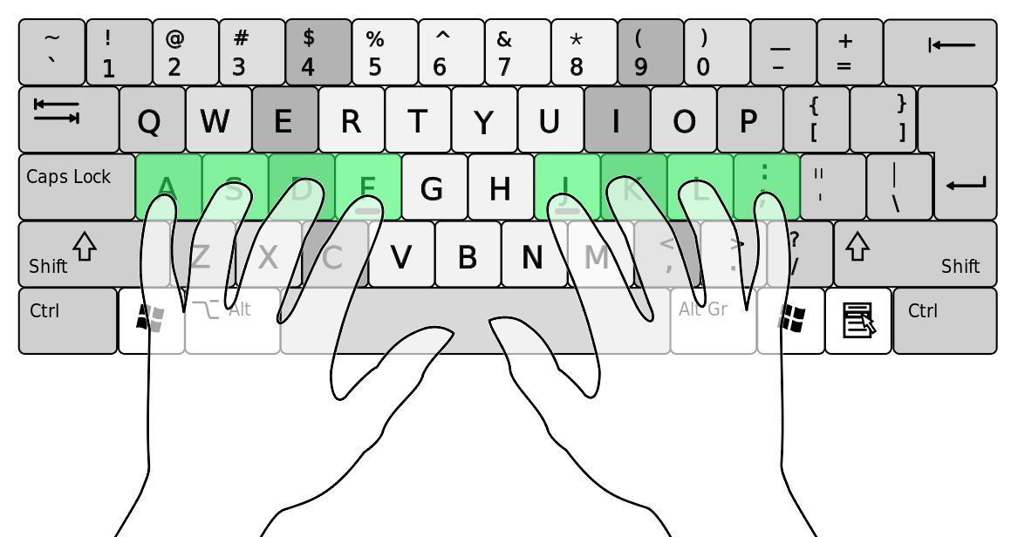
Typing Tips
Your hands should naturally rest on the Home Row (pointer fingers on F and J).
Most keyboards have raised surfaces to help you find home row without looking.
Try learning keyboard shortcuts for common actions (copying and pasting, for example) instead of relying on the mouse.
Find typing tutorials online, including: http://www.keybr.com/

Slide 32
Exercise 4: Find Your Typing Speed
Take a typing speed test at:
10fastfingers.com/typing-test/
If your speed is low (<50 wpm), don’t feel bad!
This is just something you’ll have to work on throughout the semester.

Slide 33
Textbooks – The Skimming Method
Textbooks exist for a reason – they are the first place you should go to learn more about topics that you couldn’t fully understand during course lectures.
However, textbooks should not be read completely, from top to bottom!
Textbooks contain more details than you’ll ever need or be able to remember.
Learn to skim textbooks for the information you actually need:
Find the relevant section (using the Table of Contents or Index).
Read completely the opening and closing paragraphs in the section.
Read the first sentence(s) in each paragraph.
Write a brief summary of each in your own words.
If you still don’t understand something, re-read the relevant paragraphs completely and write a detailed summary of each.

Slide 34
Studying
Going to class and doing class exercises are only the first steps to learning.
If you only do these two things, you will probably be a below-average developer.
The secret to college is that most real learning is done outside of class.
If you want to be a solid programmer, try as much of the following as you can:
Experiment and tinker – build things!
Talk with others
Find interesting books, documentation, videos, podcasts, etc.
Most importantly, code!

Slide 35

Socializing
Software development requires social skills!
Hanging out with fellow ICT students is a great way to learn how to be social, in addition to networking and finding out about cool projects and technologies.
IT Lab is a social group for ICT students. We run events like LAN Parties and Hackathons, and have an active Facebook group.
If you’re an ICT student, you’re already a member! Join our Facebook group at facebook.com/groups/itlab.via/

Slide 36
Computer Hardware

Slide 37

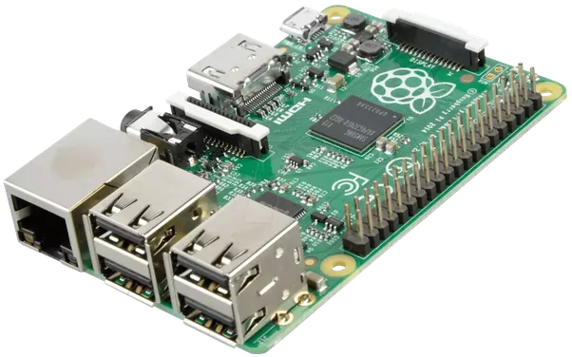
Basic Components
CPU – Central Processing Unit
“Brain of a computer”
Most logical processing
99% of programs are execute here
GPU – Graphics Processing Unit
Math and Graphics
Memory - (RAM)
Temporary storage
Anything from a webpage to a skype message
Storage – HDD, SSD
Persistent data
Notes:
I hate the term brain of a computer but it’s still somewhat fitting

Slide 38
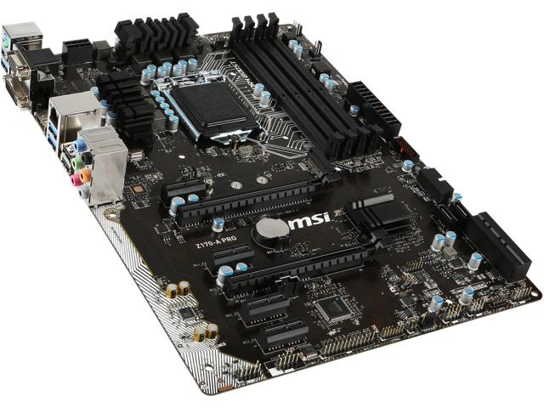
Basic Components
MOBO – Motherboard
Connects all components
PSU – Power Supply Unit
Electricity
Disk drive
Not all that useful anymore
Case
The “box” or body of your computer

Slide 39
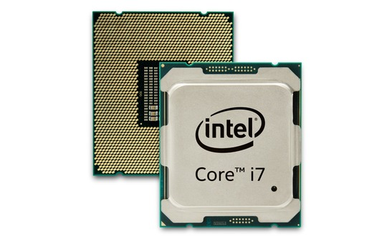
CPU - Central processing unit
99% programs run here
Nowadays we move more and more to the GPU
Usually has more than one Core
Cores usually have one or two Threads
Number of threads is the number of operations a CPU can do at once
Frequency [Ghz]
how many times a second CPU performs an operation
can be very deceiving
Two CPUs running the same frequency and same number of cores can perform very differently depending on the architecture

Slide 40
CPU
Computer CPUs are made by Intel or AMD
Intel currently holds around 80 percent of the market
It wasn’t always this way. Only a decade ago AMD was considered the champion
AMD is responsible for the 64 bit architecture
AMD is also considered the more value oriented option
Mobile CPUs are dominated by Qualcomm, Apple or Samsung
Mobile CPUs are usually on the same chip as GPU, known as SoC
It’s sometimes hard to say who makes which one
Samsung manufactures most Apple’s CPUs
Samsung also uses Qualcomm CPUS and even share architecture with them

Slide 41

Intel – i3, i5, i7 and “i9”
Meaningless marketing names
Hyperthreading – one core has two threads
Most of the time:
i3 – dual core, with or without hyperthreading
i5 – quad core, no hyperthreading
i7 – quad core, with hyperthreading
If the name ends with a U e.g. (i7-7500U) it’s always a dual core
i5 is a perfect choice for most users that want a strong CPU
Most programs only use 2 to 4 cores

Slide 42

AMD
AMD also makes GPUs
Usually more cores that are slower
Until recently they were more of a budget choice
Started using naming similar to intel
Ryzen 3, 5, 7

Slide 43
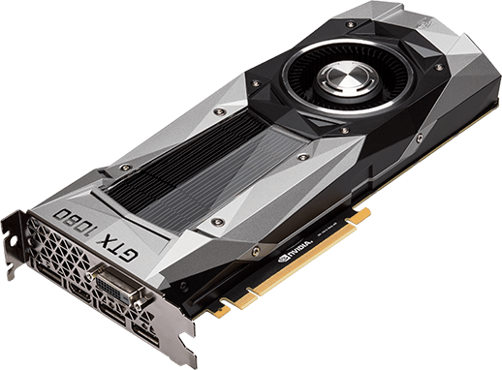
GPU - Graphics processing unit
Discrete
Separate from the CPU
Nvidia or AMD (Nvidia has 80% of computer market)
Integrated
Integrated in CPU
Intel
As opposed to CPUs, GPUs have few 100 cores
Usually have their own Memory (VRAM)
Used for: Graphics (Games, Unity,…), Machine learning (AI), Math

Slide 44
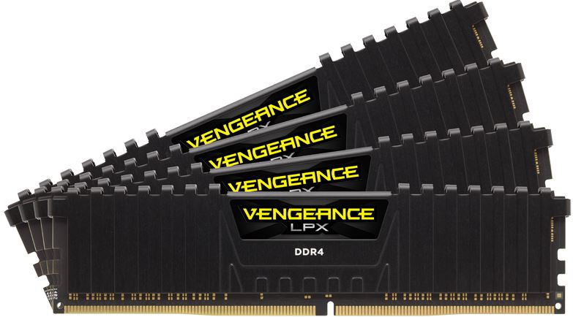
Memory (RAM)
Temporary system storage
Things are only stored here as long as computer has power
Usually 4 to 16 GB
4 GB is good enough most of the time
8 GB is What most power users want
16 GB is very good!
RAM is useful for developers
It’s used for Emulations and VMs
Used for: Video Editing, Virtual machines, Emulators, Browser tabs
Unused ram is wasted ram!

Slide 45
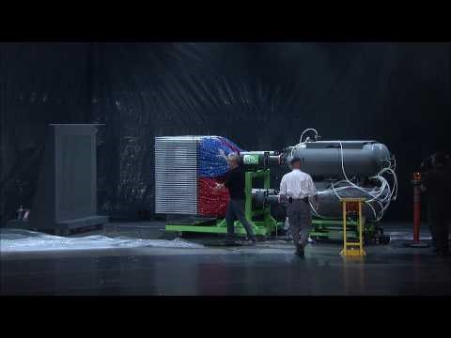

Slide 46
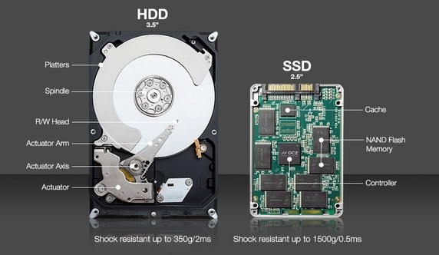
Storage
HDD – Hard disk drive
Mechanical disk
Cheap, Large capacity (Compared to SSDs for the same price)
Slow, Break a lot
SSD – Solid-state drive
Flash based (like USB drive or Memory)
Really fast (4 to 40 times faster), don’t break much (No moving parts)
Expensive (compared to HDD), small capacity

Slide 47
Exercise 5: Find your CPU and GPU
Figure out how many cores does your CPU have!
Does it have hyperthreading?
What GPU do you have?

Slide 48
Shopping for a Student Laptop
CPU:
- Intel i5 fits most purposes
Graphics:
- Intel HD (integrated into CPU) is fine if just programming
- Nvidia if graphic processing
Memory:
- 8GB will fit all but the most extreme purposes
Storage:
- SSD, but beware of ~120GB models
- HDD only if your budget is extremely limited (can be switched later)

